Slide 1


Team 60: Solar Lighting System
Final Presentation Josh George, Jeb Malek, Lyric Haylow Sponsor: Dr. Wonhyeok Jang TA: Rhett Guthrie
Notes:
Michelle

Slide 2

Project Summary
Project Deliverables
Activation of lighting system based on motion sensing and manual input.
Renewable power generation for self-powered system.
Application for checking system battery percentage and setting operational modes.
More?
Lyric Haylow
Jeb Malek
Josh George
Solar Charge Controller
Power Delivery/ Microcontroller
Mobile Application/ Microcontroller
Notes:
Kyle

Slide 3
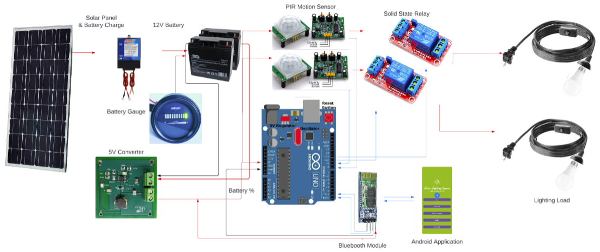
Integrated Project Diagram

Slide 4
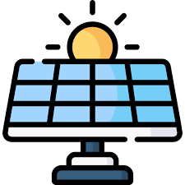
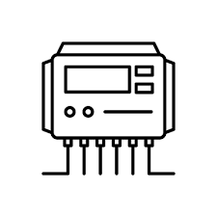


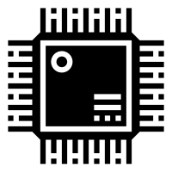
Solar Charging Overview Lyric Haylow
Solar Panels
Charge Controller
120Wh Battery
Moderates input charge from solar panels to battery
Reads battery percentage to Arduino for showing on Application
~21V
1.5A
Battery percentage read
Converter/ rest of system
MCU

Slide 5
Solar Charging Subsystem Lyric Haylow
Challenges
Max voltage accepted for Arduino is 5V
Initial board traces were incapable of handling current draw
Charge Controller isn't drawing sufficient current
Solutions
Created small circuit for stepping down voltage by factor of 0.175
Remade board with improved design for testing and handling current draw
Ordered Eval Board, have begun additional testing to check for faults

Slide 6
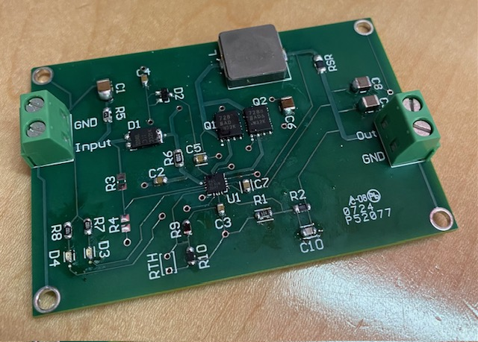
Solar Charging Results Lyric Haylow
Specification | Min | Nominal | Max
Solar Panel Input Voltage (V) | 5 | 21 | 25
Solar Panel Input Current (A) | 1 | 1.2 | 1.5
Charge Controller output current (A) | 0.5 | 2 | 10
Battery Voltage (V) | 2.1 | 12 | 26
Estimated Battery Life (hours) | 5.4 | 9 | 27
Item | Met
Controller recognizes both when to charge and when fully charged | Yes
Battery Voltage level sent to Microcontroller | Yes
Solar Panels give consistent current and expected Voltage | Yes
Controller actively charges Battery | No

Slide 7
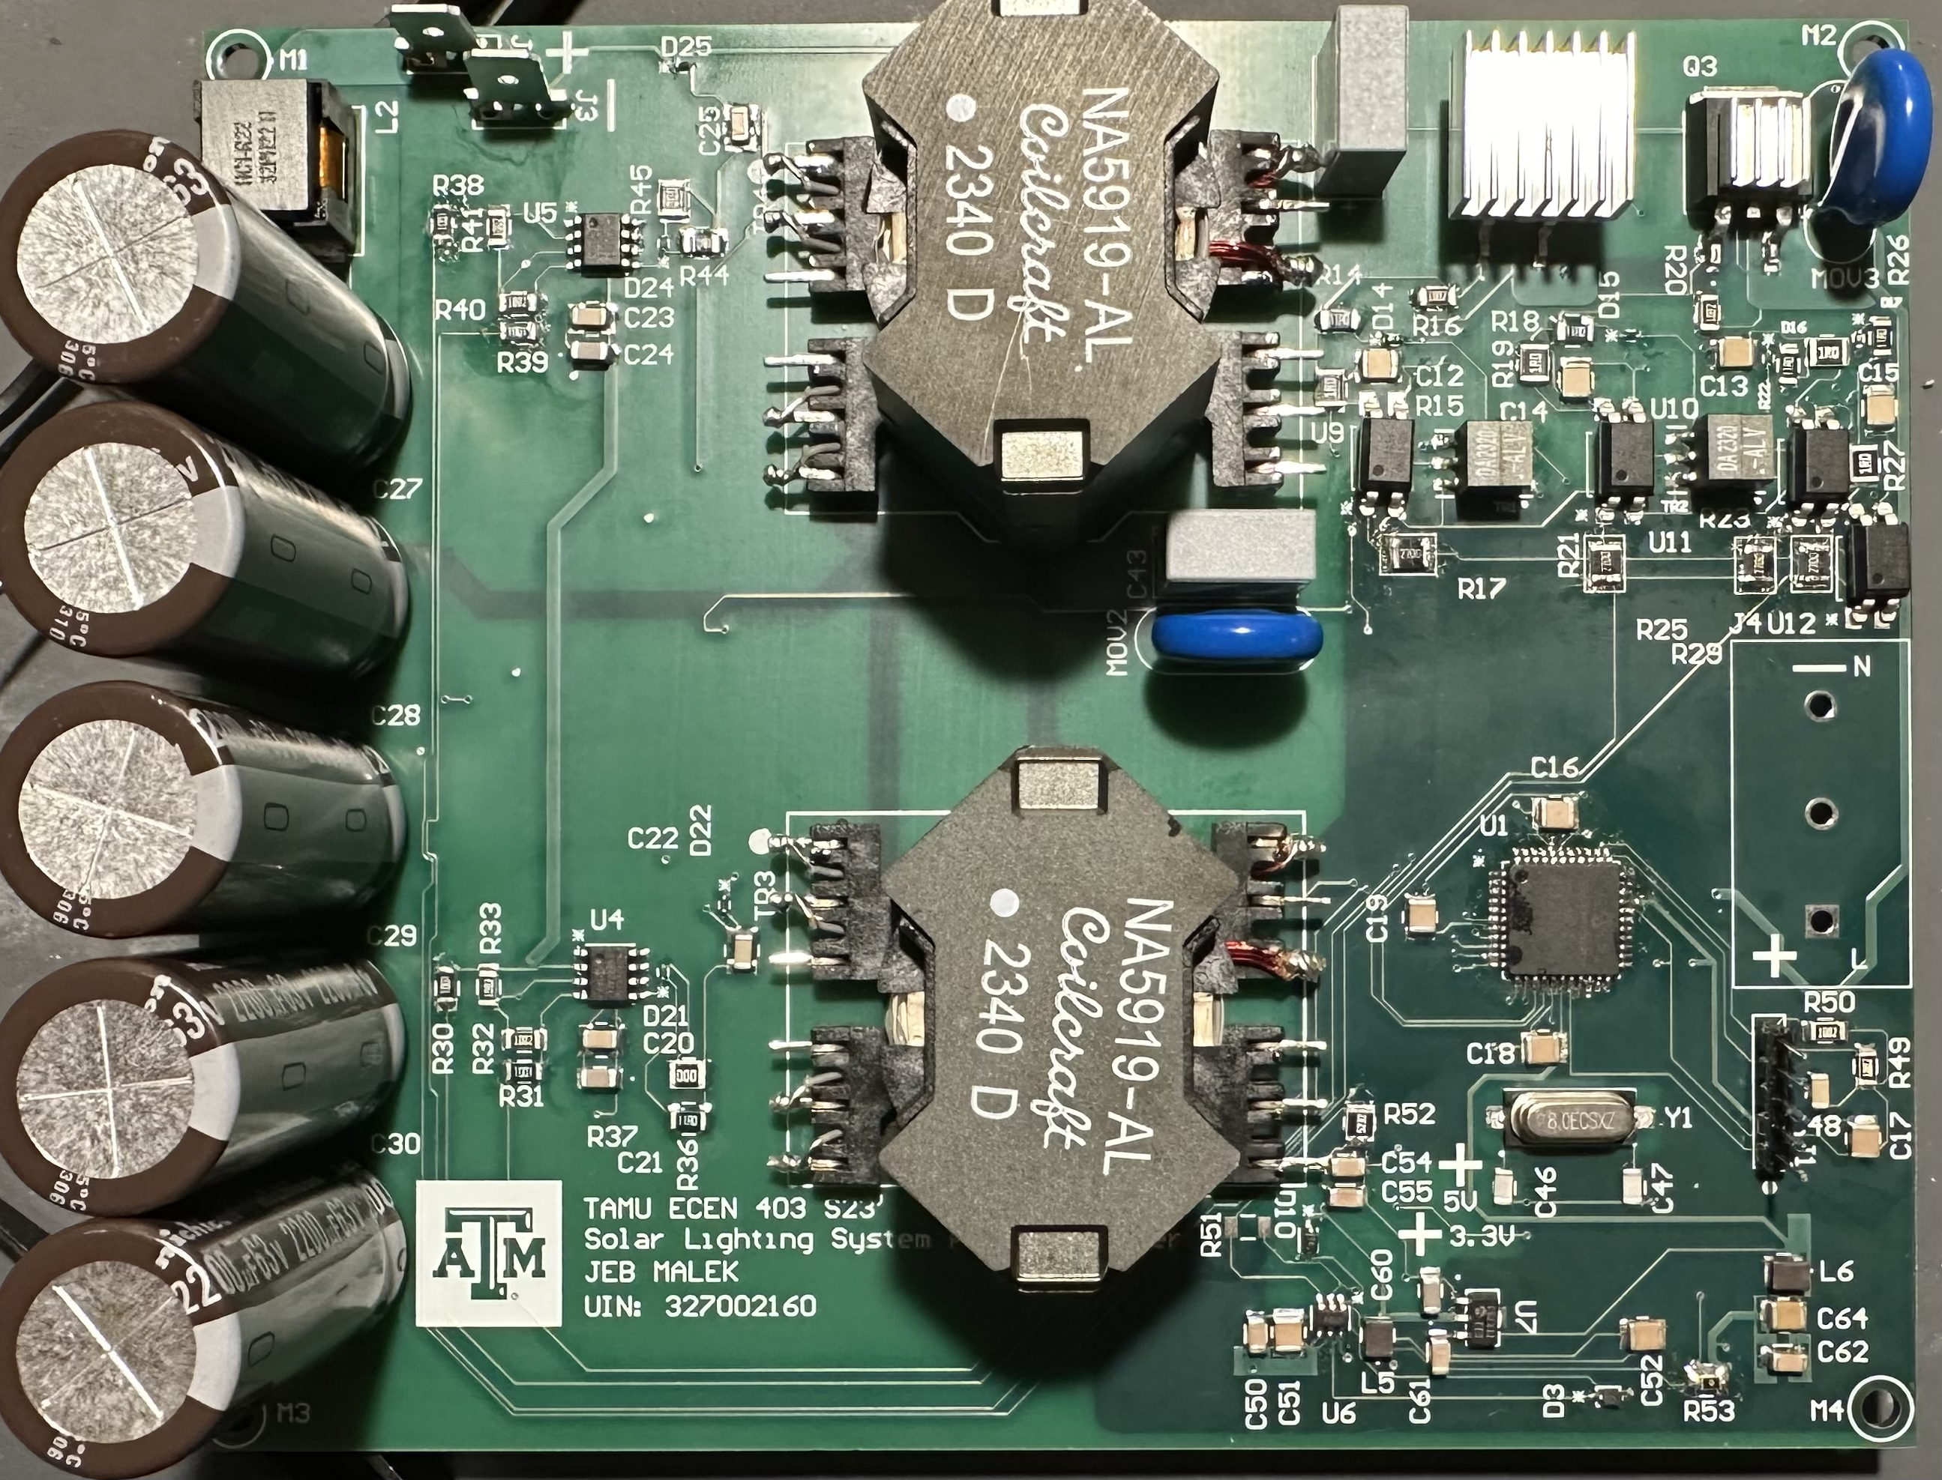
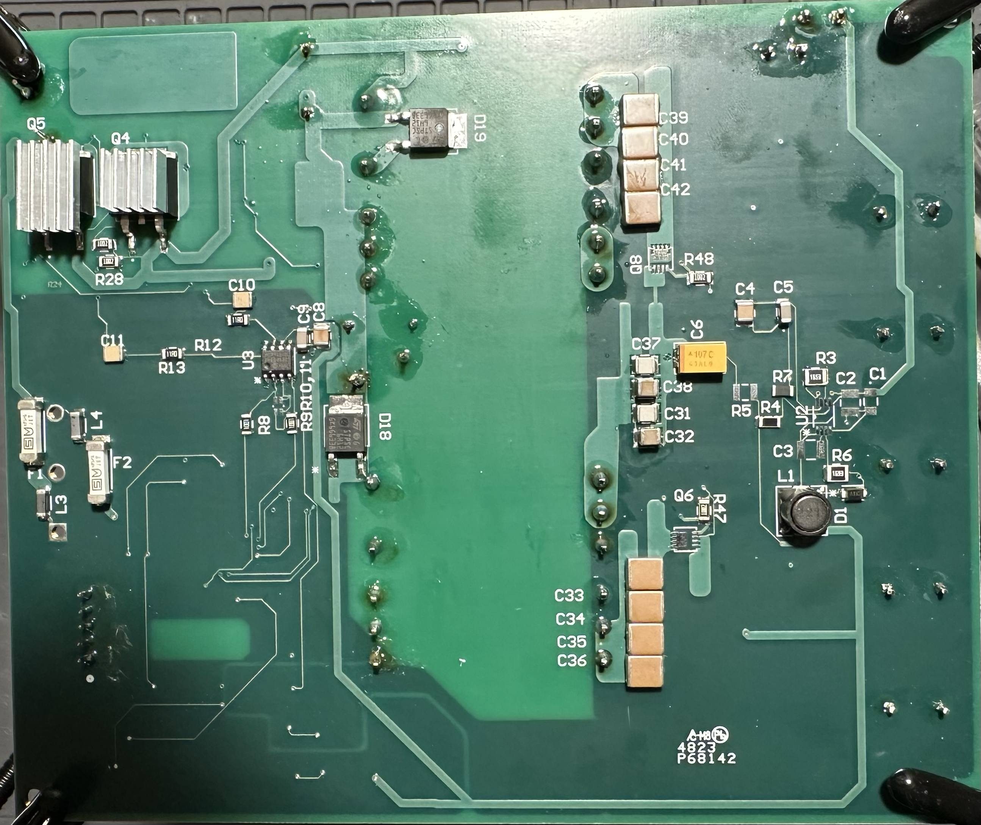
Power Delivery Subsystem
Inverter

Slide 8
Power Delivery Subsystem
Power Supply needed for Arduino, Bluetooth Module, Motion Controllers , Switches & AC Light Load
Supply | Voltage | Current | Power
Bluetooth Module | 4.91 V | 40mA | 185mW
Arduino | 4.91 V | 37-40 mA | 185-200 mW
Switches | 4.91 V | 10mA | 180mW
Sensors | 4.91 V | 1-2mA | 4.91-9.82 mW
 |  | DC Total | 550-565 mW
AC Light Load | 120V RMS | 180-200 mA | 21-22W
 |  | Nom. Total | 23W

Slide 9
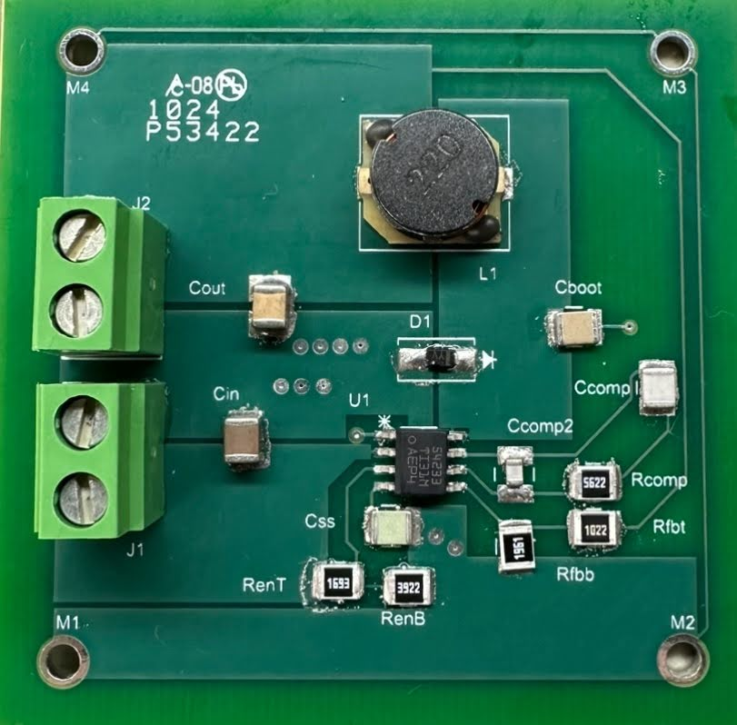
Power Delivery Subsystem
Testing & Verification of 12-5V Converter
Load : Switch & Sensor Switch , Sensor , Arduino , & BT Module
Supply : Battery
Supply | 12.27V 1A
Voltage | 4.91 V
Current | 18.183 mA

Slide 10
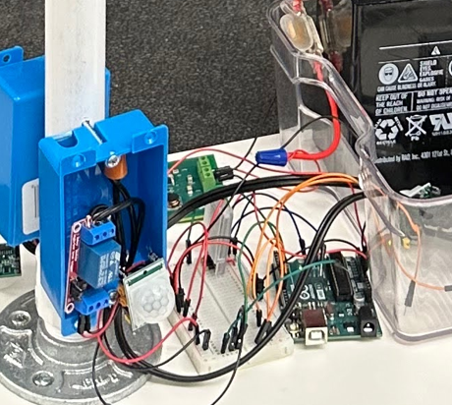
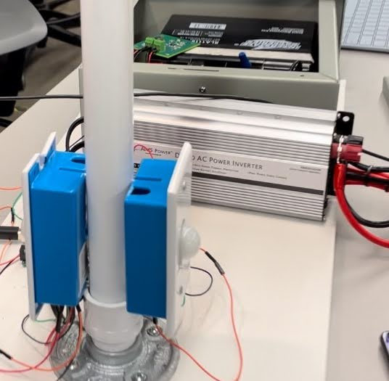
Microcontroller Subsystem
Switch and Sensor correlation validated with software adjustable delay timer
Synchronization | Sensor Pin 1 | Sensor Pin 2
Digital Timing | ~1s | ~1s
Switch Delay Timer | 100s | 100s

Slide 11
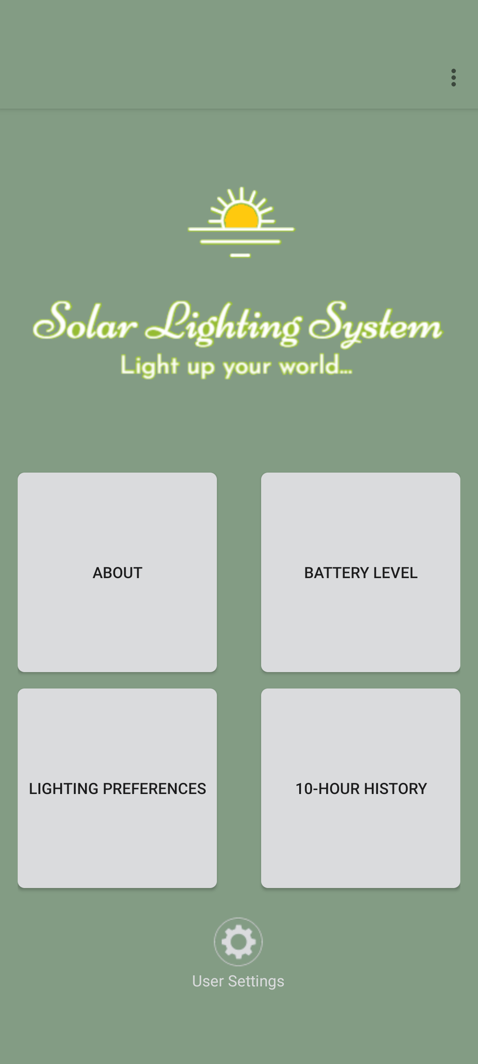
Android Application Subsystem
Outputs to the System:
Sets mode of operation for the lighting system
Manual command
Receives from System:
Current battery percentage
Miscellaneous:
10 hour battery percentage graphing using database
Custom logo and design
5 different pages, 3 pages with direct integration to system

Slide 12
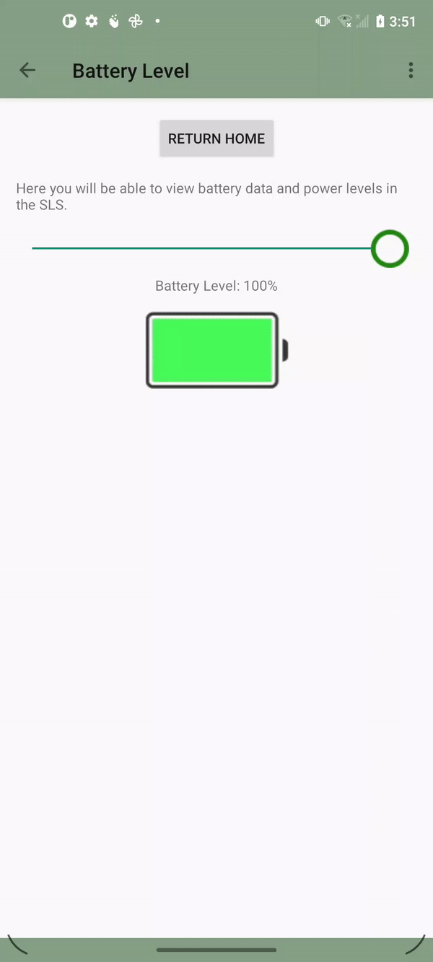
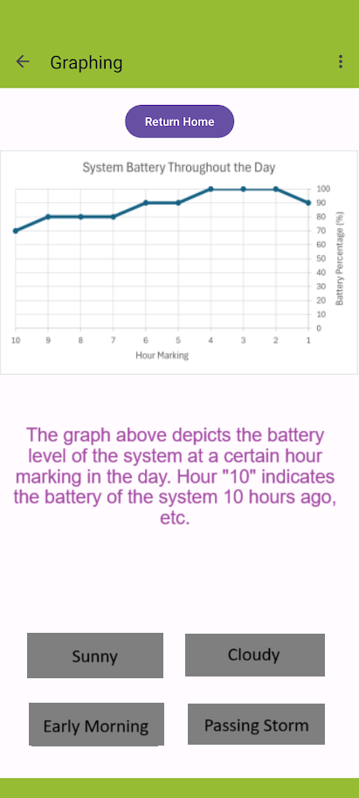
Android Application Subsystem
Tested receiving voltages from Arduino.
Have not yet validated with values from battery.
Tested with example values from Arduino board
Have not yet validated with values from battery.

Slide 13
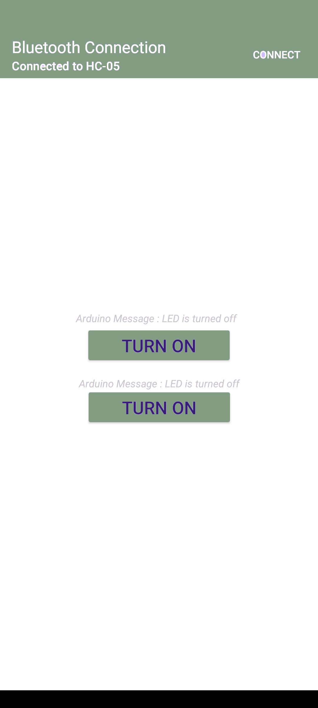
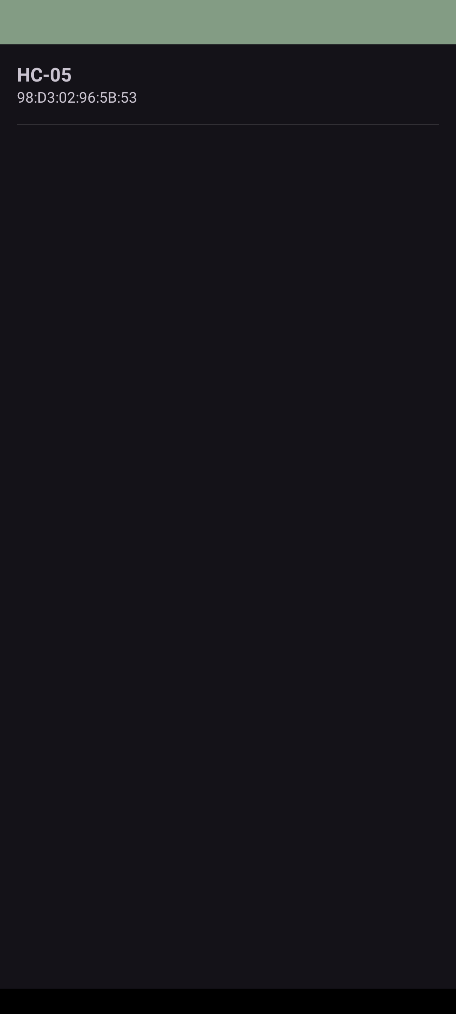
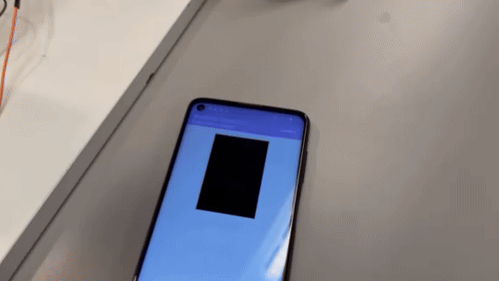
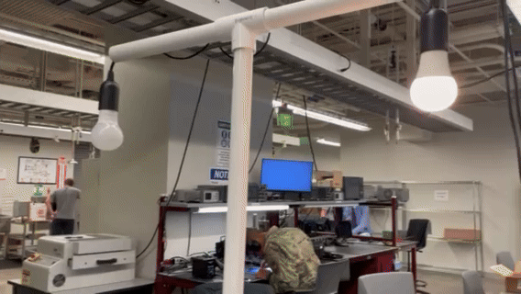

Android Application Subsystem
Complete integration with microcontroller and sensor relay system

Slide 14
Android Application Subsystem
Challenges
Bluetooth module trouble connecting to Android app
Spamming buttons on app caused Arduino cross-talk
App occasionally encounters crashes when loading Bluetooth connection
Solutions
Created a separate app and then combined with pre-existing
Added delay to user inputs to "dummy proof" system

Slide 15
Integrated System Results
System Integration | Success/Fail | Validation
Solar Panel to Battery | Success | Battery charged from 10.6V to 11.2V in one hour.
Battery to Microcontroller | Success | Arduino read battery voltage accurately within error percentage of 5%
Arduino to App | Success | App can successfully read data and provide input to the microcontroller.
Battery to App | Failure | Battery can interact with MCU, MCU can interact with App, but complete data transfer was not established.
Microcontroller to Sensors and Lighting Load | Success | Validated lights turn on when person moves in front of sensors.

Slide 16
Conclusions
Issues Encountered:
Faulty board design for inverter, so store bought industry type being used.
Flood lights were too power heavy, so we removed them from the project.
Charge controller TI design proving to be faulty, so using on-hand Charge Controller for system integration testing.
Current status : Bluetooth Integration complete, Repeating testing for motion sensing and switch timing, charge controller testing, integration/validation to be completed in 3 days.

